Slide 1
Cross Product
AKA the vector product

Slide 2
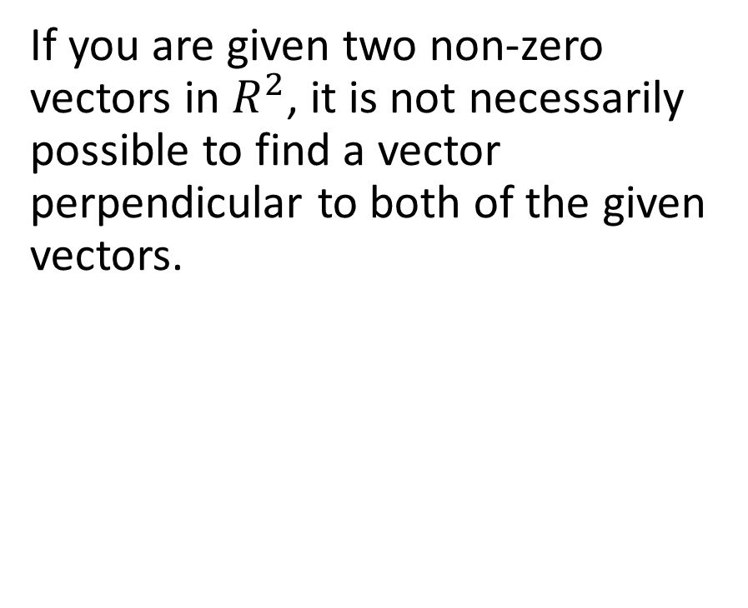
If you are given two non-zero vectors in $R^{2}$, it is not necessarily possible to find a vector perpendicular to both of the given vectors.

Slide 3
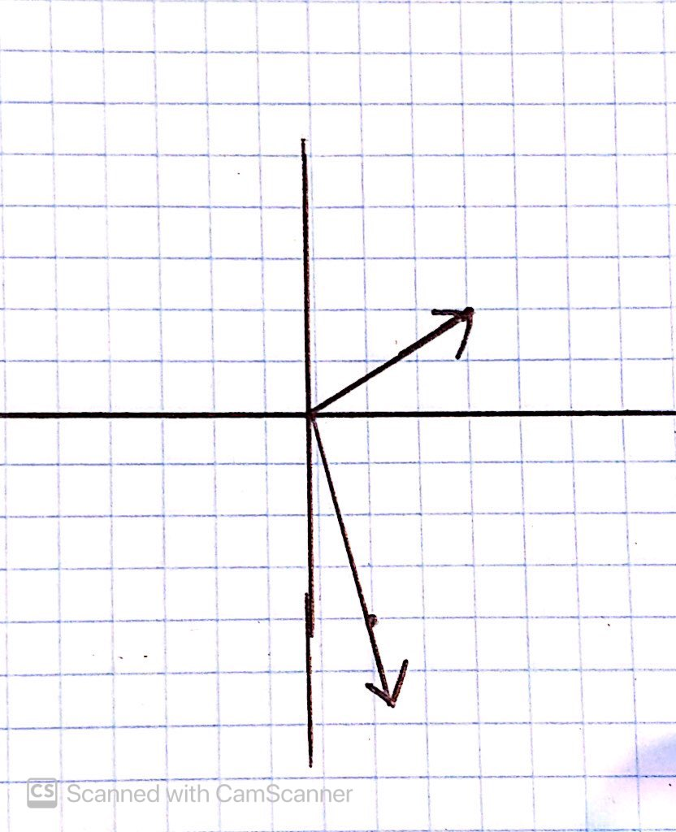
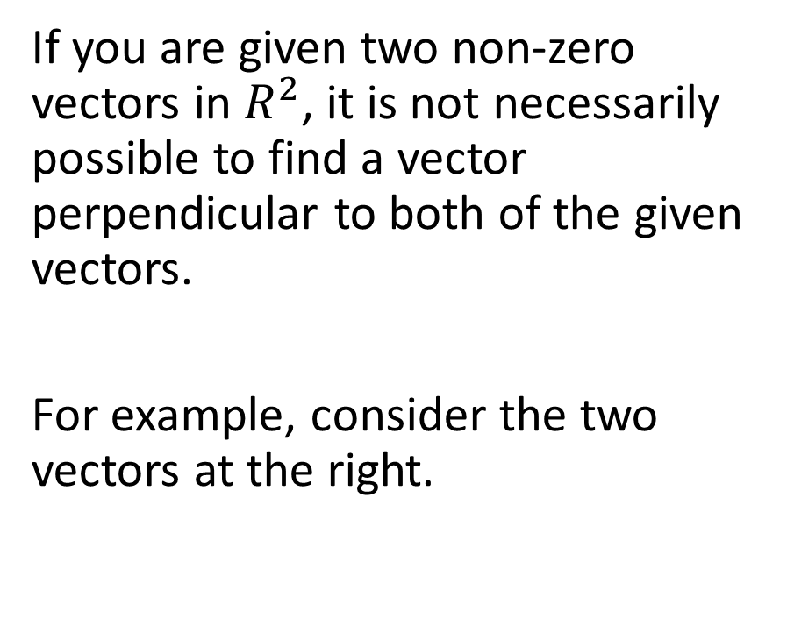
If you are given two non-zero vectors in $R^{2}$, it is not necessarily possible to find a vector perpendicular to both of the given vectors.
For example, consider the two vectors at the right.

Slide 4
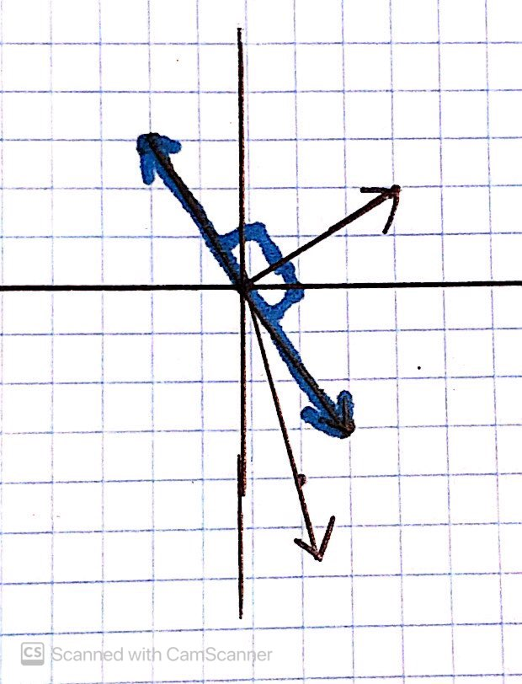
If we add either of the blue vectors shown, we see that they are perpendicular to the top vector but are not perpendicular to the bottom vector.

Slide 5
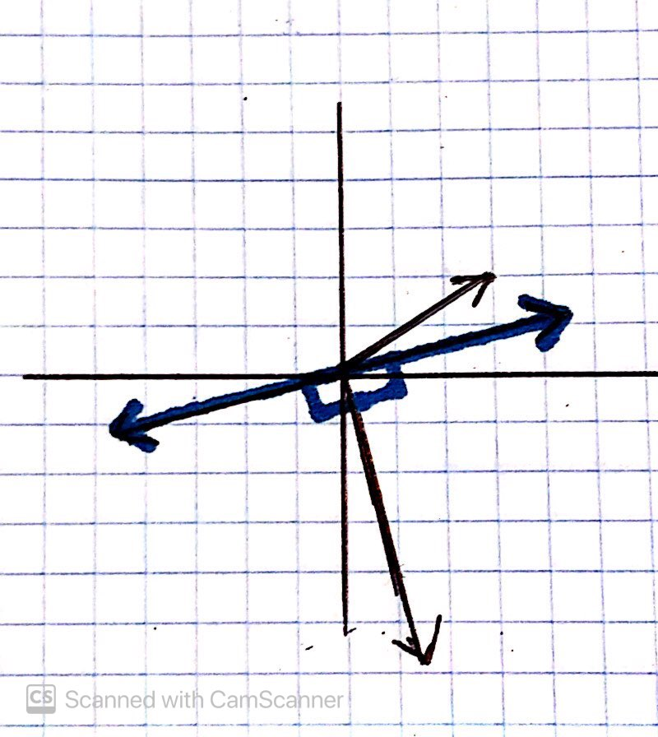
On the other hand, if we add either of the blue vectors on the right, we see that they are perpendicular to the bottom vector but not to the top vector.

Slide 6

As we can see, given two non-zero vectors in $R^{2}$, it is not always possible to determine a vector perpendicular to both of them.

Slide 7

As we can see, given two non-zero vectors in $R^{2}$, it is not always possible to determine a vector perpendicular to both of them.
However, it is a different story in $R^{3}$…

Slide 8

If you are given any two non-zero vectors in $R^{3},$it is possible to find a third vector perpendicular to both of the given vectors. One way of doing this is called the cross-product.

Slide 9
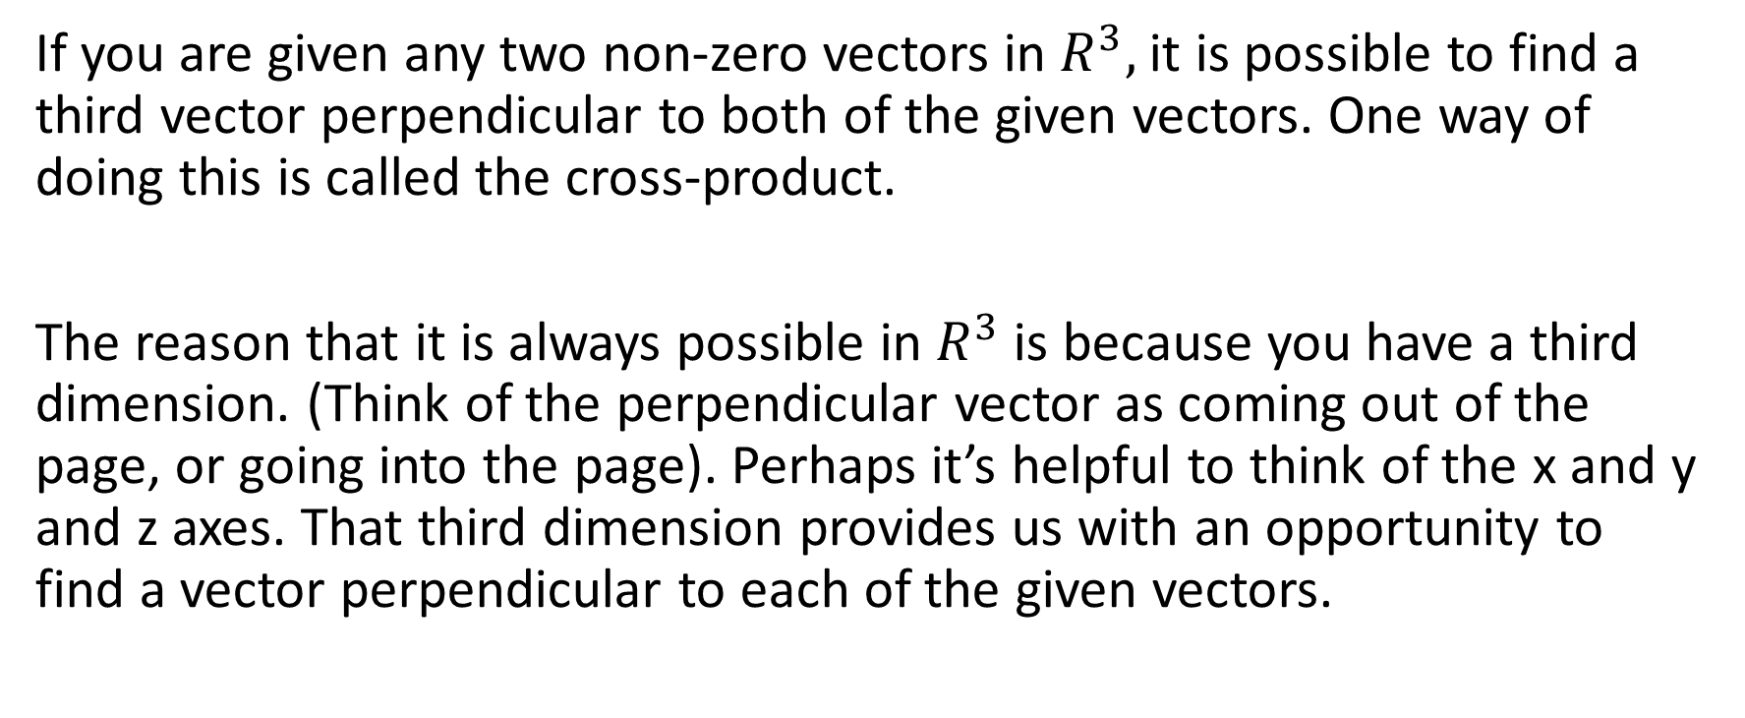
If you are given any two non-zero vectors in $R^{3},$it is possible to find a third vector perpendicular to both of the given vectors. One way of doing this is called the cross-product.
The reason that it is always possible in $R^{3}$ is because you have a third dimension. (Think of the perpendicular vector as coming out of the page, or going into the page). Perhaps it’s helpful to think of the x and y and z axes. That third dimension provides us with an opportunity to find a vector perpendicular to each of the given vectors.

Slide 10
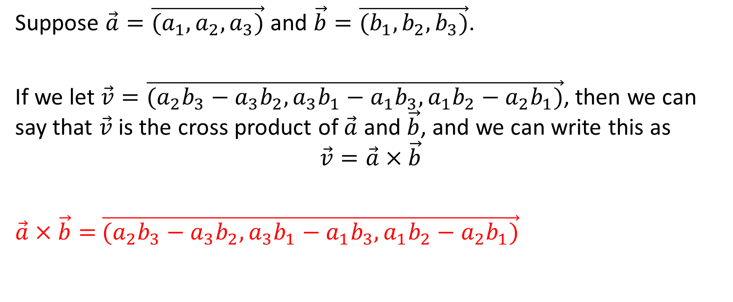
Suppose $\vec{a}=\vec{(a_{1},a_{2},a_{3})}$ and $\vec{b}=\vec{(b_{1},b_{2},b_{3})}$.
If we let $\vec{v}=\vec{(a_{2}b_{3}−a_{3}b_{2},a_{3}b_{1}−a_{1}b_{3},a_{1}b_{2}−a_{2}b_{1})}$, then we can say that $\vec{v}$ is the cross product of $\vec{a}$ and $\vec{b}$, and we can write this as
$$\vec{v}=\vec{a}×\vec{b}$$
$\vec{a}×\vec{b}=$ $\vec{(a_{2}b_{3}−a_{3}b_{2},a_{3}b_{1}−a_{1}b_{3},a_{1}b_{2}−a_{2}b_{1})}$

Slide 11
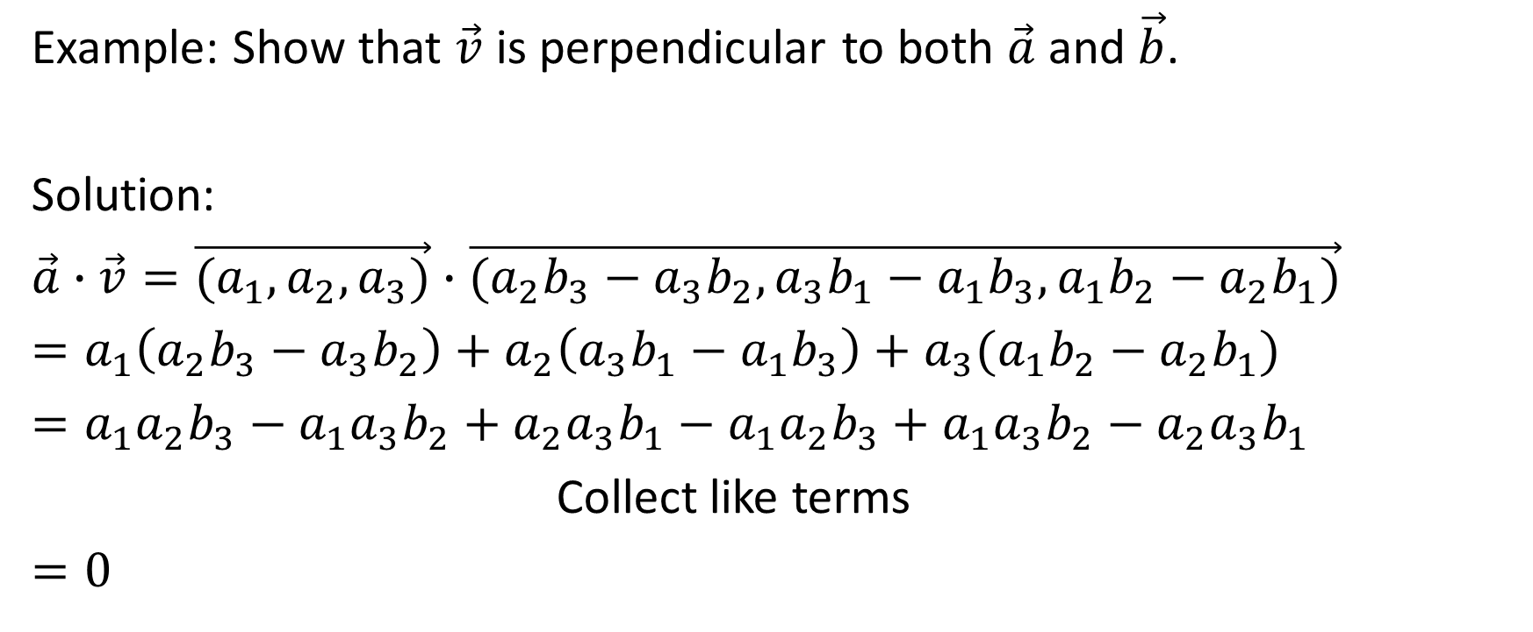
Example: Show that $\vec{v}$ is perpendicular to both $\vec{a}$ and $\vec{b}$.
Solution:
$\vec{a}∙\vec{v}=\vec{(a_{1},a_{2},a_{3})}∙$ $\vec{(a_{2}b_{3}−a_{3}b_{2},a_{3}b_{1}−a_{1}b_{3},a_{1}b_{2}−a_{2}b_{1})}$
$=a_{1}\left(a_{2}b_{3}−a_{3}b_{2}\right)+a_{2}\left(a_{3}b_{1}−a_{1}b_{3}\right)+a_{3}(a_{1}b_{2}−a_{2}b_{1})$
$=a_{1}a_{2}b_{3}−a_{1}a_{3}b_{2}+a_{2}a_{3}b_{1}−a_{1}a_{2}b_{3}+a_{1}a_{3}b_{2}−a_{2}a_{3}b_{1}$
Collect like terms
$=0$

Slide 12
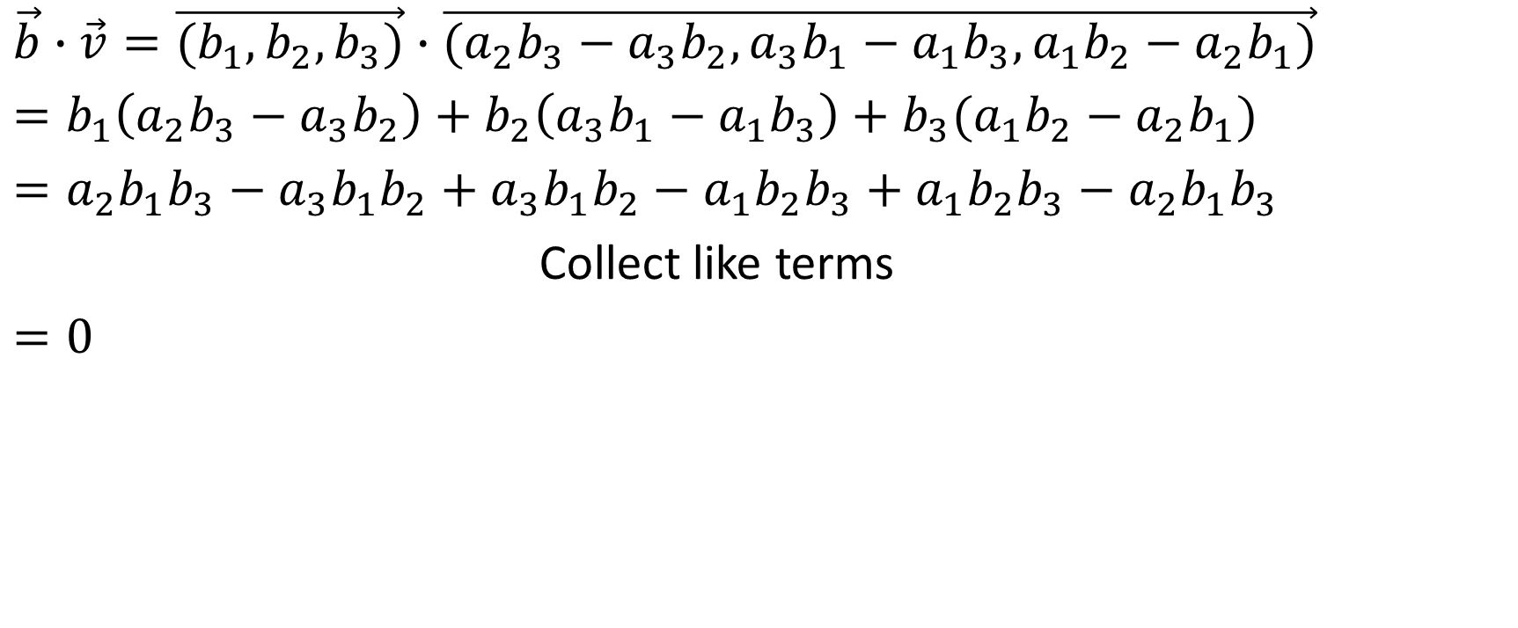
$\vec{b}∙\vec{v}=\vec{(b_{1},b_{2},b_{3})}∙$ $\vec{(a_{2}b_{3}−a_{3}b_{2},a_{3}b_{1}−a_{1}b_{3},a_{1}b_{2}−a_{2}b_{1})}$
$=b_{1}\left(a_{2}b_{3}−a_{3}b_{2}\right)+b_{2}\left(a_{3}b_{1}−a_{1}b_{3}\right)+b_{3}(a_{1}b_{2}−a_{2}b_{1})$
$=a_{2}b_{1}b_{3}−a_{3}b_{1}b_{2}+a_{3}b_{1}b_{2}−a_{1}b_{2}b_{3}+a_{1}b_{2}b_{3}−a_{2}b_{1}b_{3}$
Collect like terms
$=0$

Slide 13
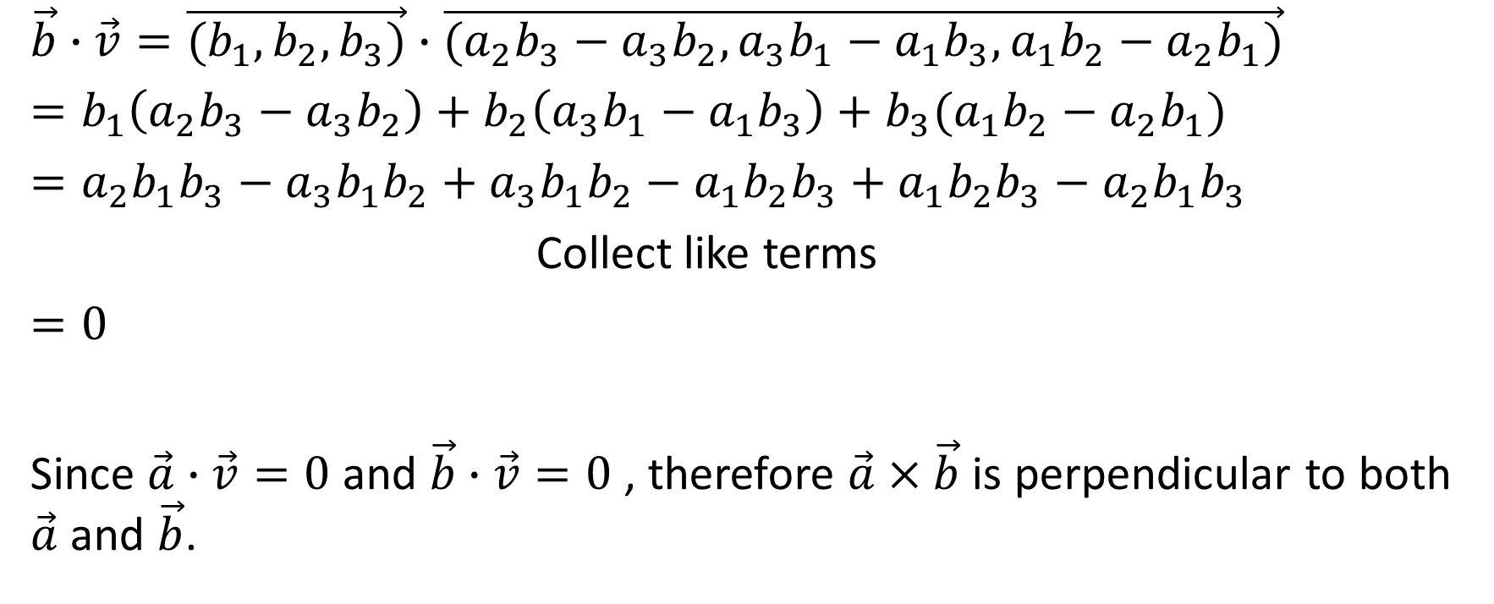
$\vec{b}∙\vec{v}=\vec{(b_{1},b_{2},b_{3})}∙$ $\vec{(a_{2}b_{3}−a_{3}b_{2},a_{3}b_{1}−a_{1}b_{3},a_{1}b_{2}−a_{2}b_{1})}$
$=b_{1}\left(a_{2}b_{3}−a_{3}b_{2}\right)+b_{2}\left(a_{3}b_{1}−a_{1}b_{3}\right)+b_{3}(a_{1}b_{2}−a_{2}b_{1})$
$=a_{2}b_{1}b_{3}−a_{3}b_{1}b_{2}+a_{3}b_{1}b_{2}−a_{1}b_{2}b_{3}+a_{1}b_{2}b_{3}−a_{2}b_{1}b_{3}$
Collect like terms
$=0$
Since $\vec{a}∙\vec{v}=0$ and $\vec{b}∙\vec{v}=0$ , therefore $\vec{a}×\vec{b}$ is perpendicular to both $\vec{a}$ and $\vec{b}$.

Slide 14








Slide 15







Slide 16












Slide 17


























Slide 18



Slide 19






Slide 20




Slide 21





Slide 22














Slide 23









Slide 24






Slide 25



Slide 26






Slide 27













Slide 28





Slide 29




















Slide 30















Slide 31






Slide 32


Slide 33















Slide 34








Slide 35



Slide 37










Slide 38








Slide 39






Slide 40
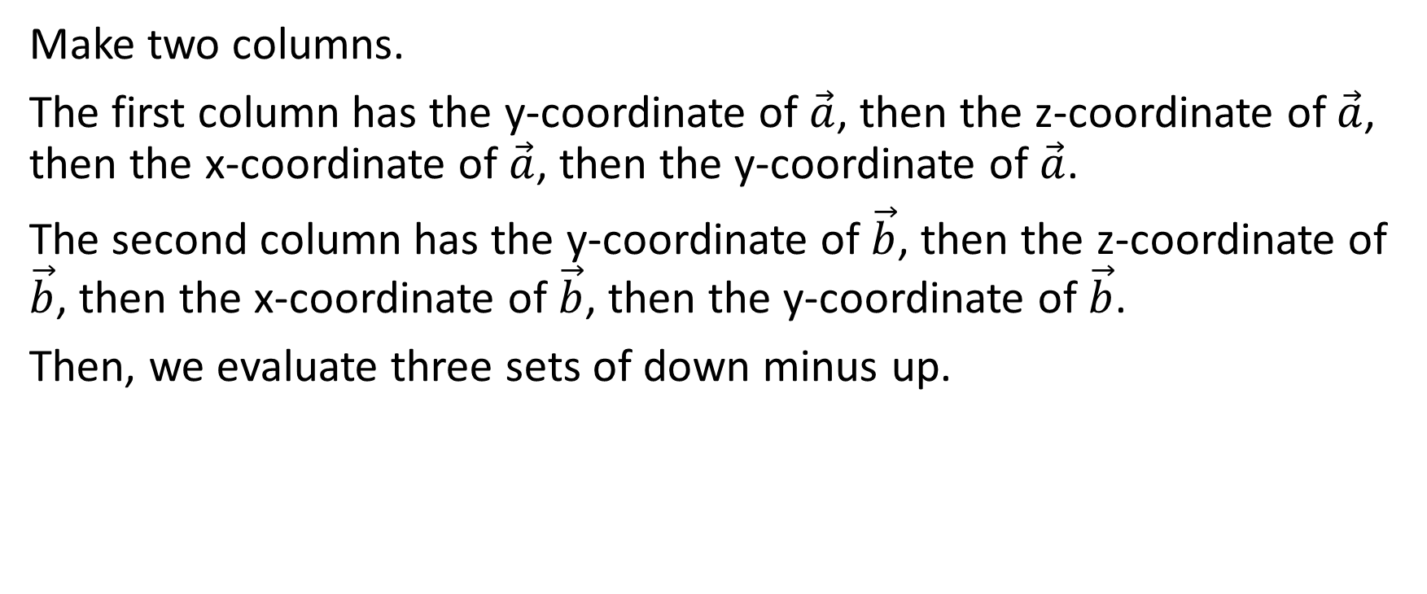

Process for Determining $\vec{a}×\vec{b}$
Make two columns.
The first column has the y-coordinate of $\vec{a}$, then the z-coordinate of $\vec{a}$, then the x-coordinate of $\vec{a}$, then the y-coordinate of $\vec{a}$.
The second column has the y-coordinate of $\vec{b}$, then the z-coordinate of $\vec{b}$, then the x-coordinate of $\vec{b}$, then the y-coordinate of $\vec{b}$.
Then, we evaluate three sets of down minus up.

Slide 41

Example (includes a process for determining the cross product)
Given that $\vec{p}=\vec{(−1,3,2)}$ and that $\vec{q}=\vec{(2,−5,6)}$, determine $\vec{p}×\vec{q}$ and $\vec{q}×\vec{p}$. Then determine that each of them is perpendicular to each of $\vec{p}$ and $\vec{q}$.

Slide 42
Example (includes a process for determining the cross product)
Given that $\vec{p}=\vec{(−1,3,2)}$ and that $\vec{q}=\vec{(2,−5,6)}$, determine $\vec{p}×\vec{q}$ and $\vec{q}×\vec{p}$. Then determine that each of them is perpendicular to each of $\vec{p}$ and $\vec{q}$.
Solution:
-5
6
-1 2
3 -5

Slide 43
Example (includes a process for determining the cross product)
Given that $\vec{p}=\vec{(−1,3,2)}$ and that $\vec{q}=\vec{(2,−5,6)}$, determine $\vec{p}×\vec{q}$ and $\vec{q}×\vec{p}$. Then determine that each of them is perpendicular to each of $\vec{p}$ and $\vec{q}$.
Solution:
-5
6
-1 2
3 -5

Slide 44



Example (includes a process for determining the cross product)
Given that $\vec{p}=\vec{(−1,3,2)}$ and that $\vec{q}=\vec{(2,−5,6)}$, determine $\vec{p}×\vec{q}$ and $\vec{q}×\vec{p}$. Then determine that each of them is perpendicular to each of $\vec{p}$ and $\vec{q}$.
Solution:
-5
6
-1 2
3 -5

Slide 45


Example (includes a process for determining the cross product)
Given that $\vec{p}=\vec{(−1,3,2)}$ and that $\vec{q}=\vec{(2,−5,6)}$, determine $\vec{p}×\vec{q}$ and $\vec{q}×\vec{p}$. Then determine that each of them is perpendicular to each of $\vec{p}$ and $\vec{q}$.
Solution:
-5
6
-1 2
3 -5

Slide 46

Example (includes a process for determining the cross product)
Given that $\vec{p}=\vec{(−1,3,2)}$ and that $\vec{q}=\vec{(2,−5,6)}$, determine $\vec{p}×\vec{q}$ and $\vec{q}×\vec{p}$. Then determine that each of them is perpendicular to each of $\vec{p}$ and $\vec{q}$.
Solution:
-5
6
-1 2
3 -5

Slide 47

Example (includes a process for determining the cross product)
Given that $\vec{p}=\vec{(−1,3,2)}$ and that $\vec{q}=\vec{(2,−5,6)}$, determine $\vec{p}×\vec{q}$ and $\vec{q}×\vec{p}$. Then determine that each of them is perpendicular to each of $\vec{p}$ and $\vec{q}$.
Solution:
-5
6
-1 2
-5
$\vec{(−1,3,2)}×\vec{(2,−5,6)}=\vec{(28,10,−1)}$

Slide 48

Example (includes a process for determining the cross product)
Given that $\vec{p}=\vec{(−1,3,2)}$ and that $\vec{q}=\vec{(2,−5,6)}$, determine $\vec{p}×\vec{q}$ and $\vec{q}×\vec{p}$. Then determine that each of them is perpendicular to each of $\vec{p}$ and $\vec{q}$.
$\vec{(−1,3,2)}∙\vec{(28,10,−1)}$
$=−28+30−2$
$=0$
$\vec{(2,−5,6)}∙\vec{(28,10,−1)}$
$=56−50−6$
$=0$

Slide 49

Example (includes a process for determining the cross product)
Given that $\vec{p}=\vec{(−1,3,2)}$ and that $\vec{q}=\vec{(2,−5,6)}$, determine $\vec{p}×\vec{q}$ and $\vec{q}×\vec{p}$. Then determine that each of them is perpendicular to each of $\vec{p}$ and $\vec{q}$.
Solution:
Now let’s determine $\vec{q}×\vec{p}$

Slide 50

Example (includes a process for determining the cross product)
Given that $\vec{p}=\vec{(−1,3,2)}$ and that $\vec{q}=\vec{(2,−5,6)}$, determine $\vec{p}×\vec{q}$ and $\vec{q}×\vec{p}$. Then determine that each of them is perpendicular to each of $\vec{p}$ and $\vec{q}$.
Solution:
Now let’s determine $\vec{q}×\vec{p}$
-5 3
6 2
2 -1
-5 3

Slide 51
Example (includes a process for determining the cross product)
Given that $\vec{p}=\vec{(−1,3,2)}$ and that $\vec{q}=\vec{(2,−5,6)}$, determine $\vec{p}×\vec{q}$ and $\vec{q}×\vec{p}$. Then determine that each of them is perpendicular to each of $\vec{p}$ and $\vec{q}$.
Solution:
Now let’s determine $\vec{q}×\vec{p}$
-5 3
6 2
2 -1
-5 3

Slide 52



Example (includes a process for determining the cross product)
Given that $\vec{p}=\vec{(−1,3,2)}$ and that $\vec{q}=\vec{(2,−5,6)}$, determine $\vec{p}×\vec{q}$ and $\vec{q}×\vec{p}$. Then determine that each of them is perpendicular to each of $\vec{p}$ and $\vec{q}$.
Solution:
Now let’s determine $\vec{q}×\vec{p}$
-5 3
6 2
2 -1
-5 3

Slide 53

Example (includes a process for determining the cross product)
Given that $\vec{p}=\vec{(−1,3,2)}$ and that $\vec{q}=\vec{(2,−5,6)}$, determine $\vec{p}×\vec{q}$ and $\vec{q}×\vec{p}$. Then determine that each of them is perpendicular to each of $\vec{p}$ and $\vec{q}$.
Solution:
Now let’s determine $\vec{q}×\vec{p}$
-5 3
6 2
2 -1
-5 3

Slide 54
Example (includes a process for determining the cross product)
Given that $\vec{p}=\vec{(−1,3,2)}$ and that $\vec{q}=\vec{(2,−5,6)}$, determine $\vec{p}×\vec{q}$ and $\vec{q}×\vec{p}$. Then determine that each of them is perpendicular to each of $\vec{p}$ and $\vec{q}$.
Solution:
Now let’s determine $\vec{q}×\vec{p}$
-5 3
6 2
2 -1
-5 3

Slide 55
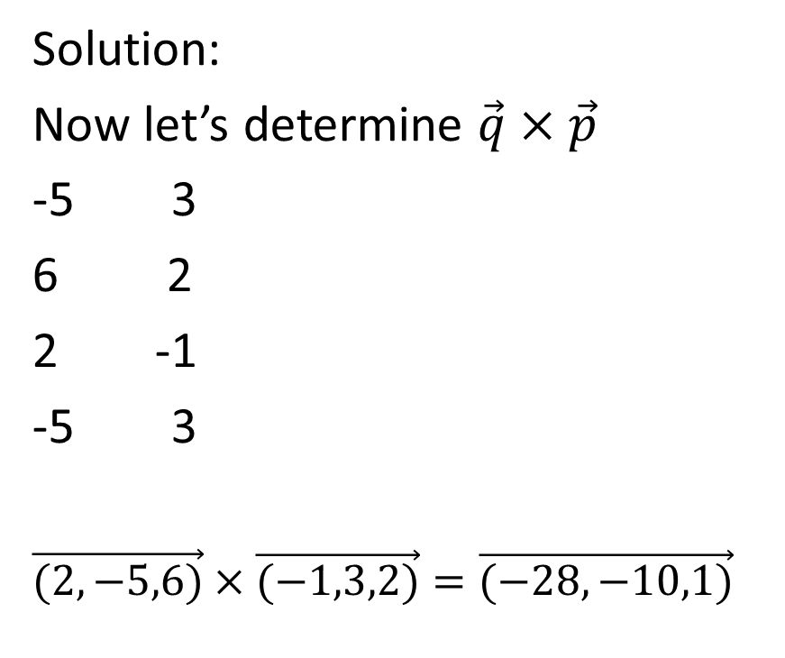
Example (includes a process for determining the cross product)
Given that $\vec{p}=\vec{(−1,3,2)}$ and that $\vec{q}=\vec{(2,−5,6)}$, determine $\vec{p}×\vec{q}$ and $\vec{q}×\vec{p}$. Then determine that each of them is perpendicular to each of $\vec{p}$ and $\vec{q}$.
Solution:
Now let’s determine $\vec{q}×\vec{p}$
-5 3
6 2
2 -1
-5 3
$\vec{(2,−5,6)}×\vec{(−1,3,2)}=\vec{(−28,−10,1)}$

Slide 56

Example (includes a process for determining the cross product)
Given that $\vec{p}=\vec{(−1,3,2)}$ and that $\vec{q}=\vec{(2,−5,6)}$, determine $\vec{p}×\vec{q}$ and $\vec{q}×\vec{p}$. Then determine that each of them is perpendicular to each of $\vec{p}$ and $\vec{q}$.
$\vec{(−1,3,2)}∙\vec{(−28,−10,1)}$
$=28−30+2$
$=0$
$\vec{(2,−5,6)}∙\vec{(−28,−10,1)}$
$=−56+50+6$
$=0$

